Slide 1
Digital image processing lab 6
Ubaid Ur Rahman

Slide 2
outlines
Image enhancement in frequency domain
Low pass and High pass filters
Point operations
Image Contours

Slide 3
Discrete Fourier Transform
The general idea is that the image (f(x,y) of size M x N) will be represented in the frequency domain (F(u,v)).
We can utilize Fourier Transformation to transform our image information - gray scaled pixels into frequencies and do further process.
Digital images, unlike light wave and sound wave in real life, are discrete because pixels are not continuous.
Ordinary DFT is slow, so we chose Fast Fourier Transformation (FFT).

Slide 4
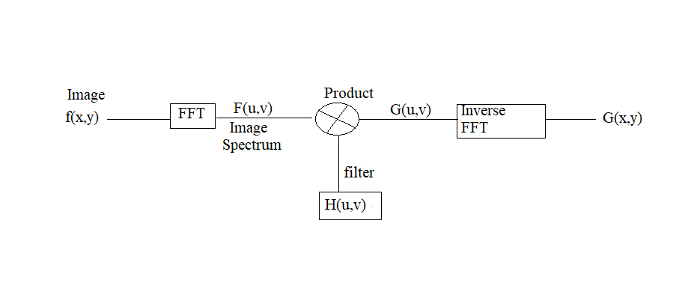

Slide 5
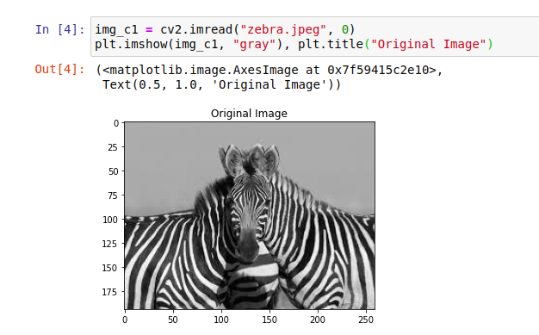
Code part 1 (read an Image)

Slide 6
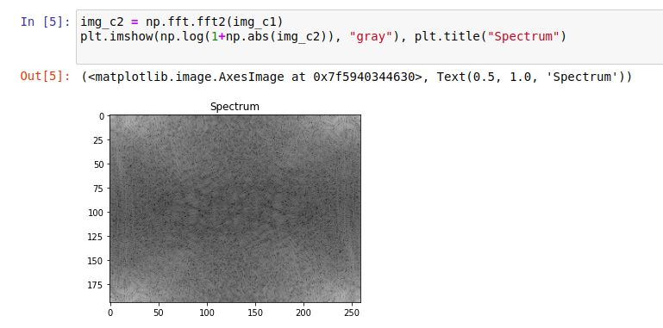
Code part 2(Apply fft)

Slide 7
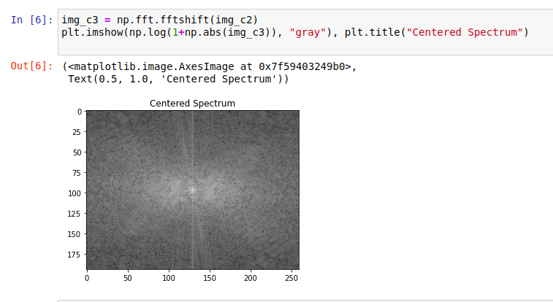
Code part 3(take origin from corner to center)

Slide 8
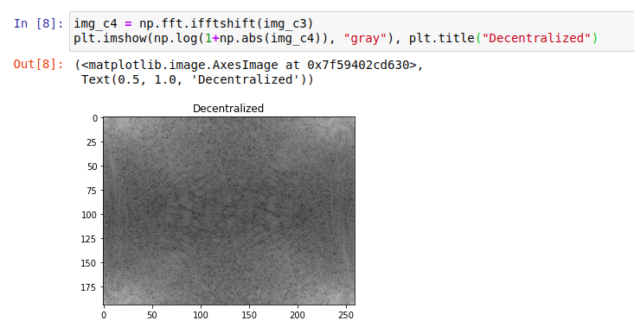
Code part 4(decentralize the origin back)

Slide 9
filters
Low pass filters:
Low pass filter is a filter that only allow low frequencies to pass through. Low frequencies in images mean pixel values that are changing slowly.
Since the output of low pass filter only allow low frequencies to pass through, the high frequencies contents such as noises are blocked which make processed image has less noisy pixels. Therefore, low pass filter is highly used to remove the noises in images.
High pass filters:
High Pass filter, on the contrary, is a filter that only allow high frequencies to pass through. High frequencies in images mean pixel values that are changing dramatically.
This will enhance sharpness in original image making edges more clear.

Slide 10
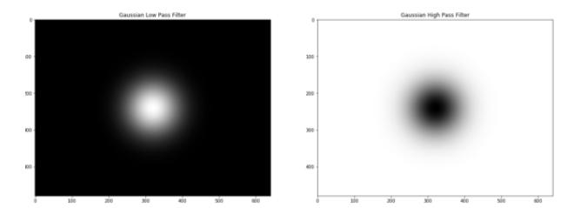
Gaussian filters

Slide 11
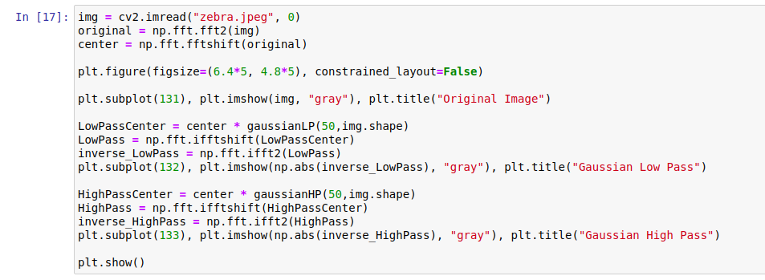
code

Slide 12
Gaussian filters

Slide 13
Point Operations
Point operations are manipulations performed directly on the values of the pixels to transform the images to the desired form.
Image Negative
Power Law transformation

Slide 14
Image negative
We subtract the value of intensity of each pixel from maximum intensity based on the quantization or amplitude to which pixels are constrained.
For an 8-bit grayscale image, the maximum value of intensity is 255, thus every pixel is subtracted from 255 to get the negative of an image.
In other words, darkest regions appear brightest and lightest areas now appear darkest.

Slide 15
code
# Read original image
image = cv2.imread('dog.jpg')
# Max intensity based on quantization
L = image.max()
# Subtract each intensity from max to obtain negative
negative = L - image
cv2.imshow('original', image)
cv2.imshow('negative', negative)
cv2.waitKey(0)
cv2.destroyAllWindows()

Slide 16
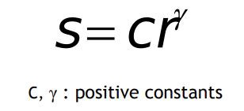
power Law Transformation
Also known as gamma correlation deals with gamma levels (γ) in the images, widely used for contrast enhancement.
S denotes output gray levels and r denotes input gray levels.

Slide 17
code
# Open the image.
image = cv2.imread('dog.jpg')
# Sample gamma values to test
for gamma in [0.2, 0.5, 1, 1.5, 1.8]:
# Apply gamma correction.
gamma_transformation = np.array(255*(image / 255) ** gamma, dtype = 'uint8')
cv2.imwrite('gamma_transformed'+str(gamma)+'.jpg', gamma_transformation)
cv2.waitKey(0)
cv2.destroyAllWindows()

Slide 18
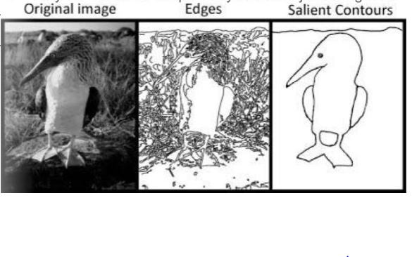
Contours in Images

Slide 19
code

Slide 20
Code 2

Slide 21
Thank you

